Slide 1
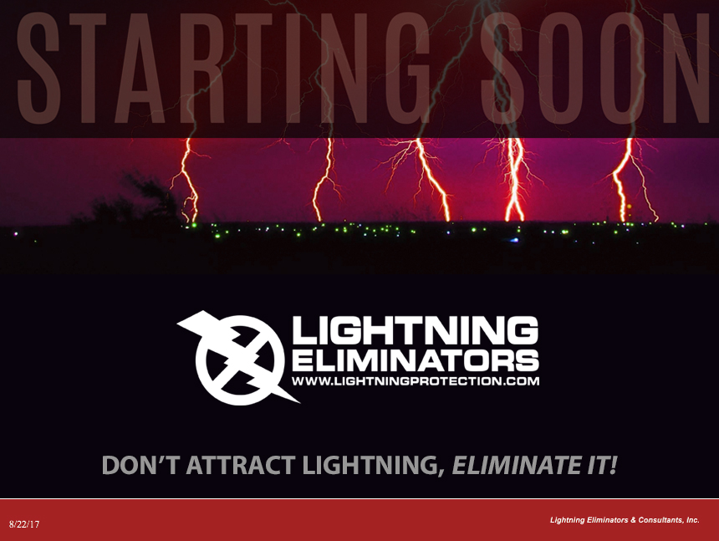

Slide 2
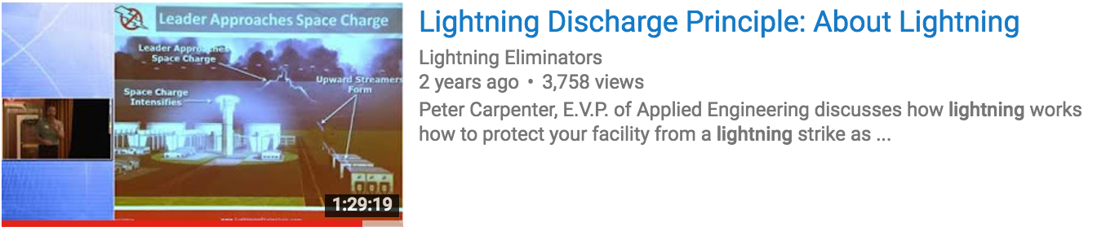
LIGHTNING SAFETY AND ACCIDENT PROTECTION
Detailed Presentation Available on YouTube!
https://youtu.be/FTQJBM7Z9LU
By Peter Carpenter, Director of Applied Engineering

Slide 3
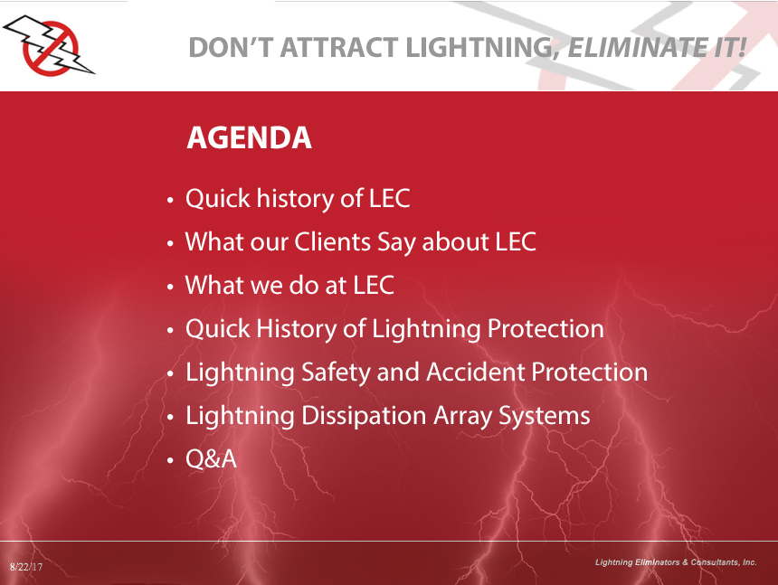

Slide 4
History of LEC
Founded in 1971 by NASA Engineer Roy Carpenter
14 US patents with 2 more pending
Over 70,000 system years in operation worldwide
Dozens of Fortune 100 clients, such as: FedEx, Exxon, Chevron, BASF, International Paper, TVA, Shell, BP, UPS, Turner Broadcasting, NASA, etc.
Notes:
Founded in 1971 by NASA Engineer Roy Carpenter

Slide 5
What Our Clients Say

Slide 6
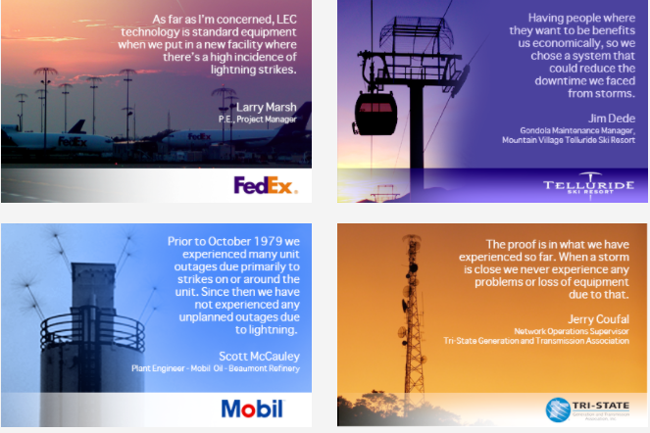
Testimonials

Slide 7
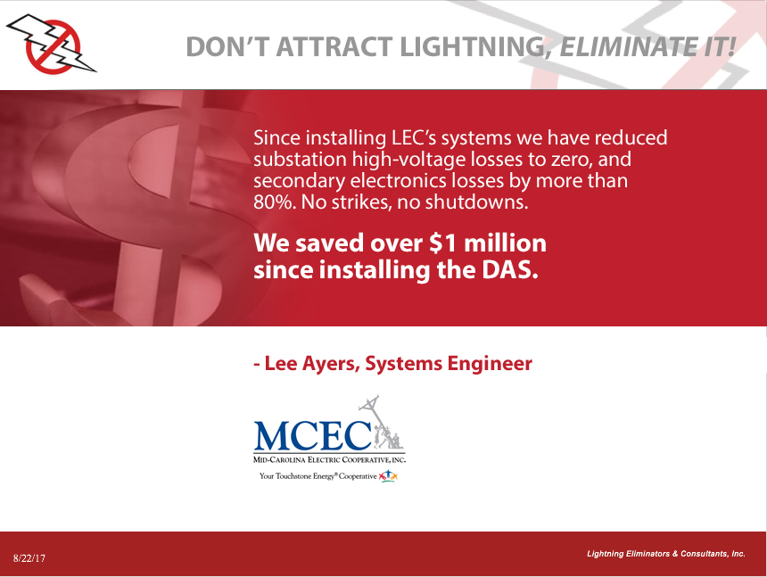

Slide 8
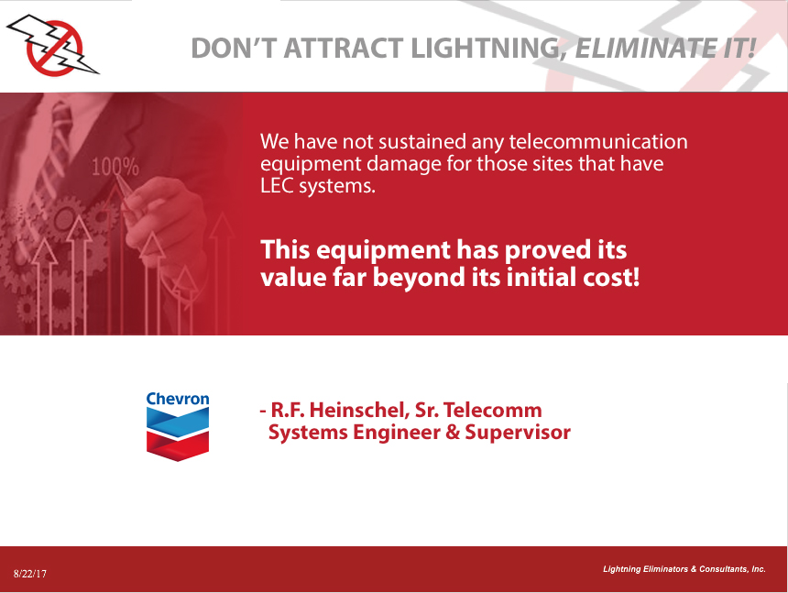

Slide 9
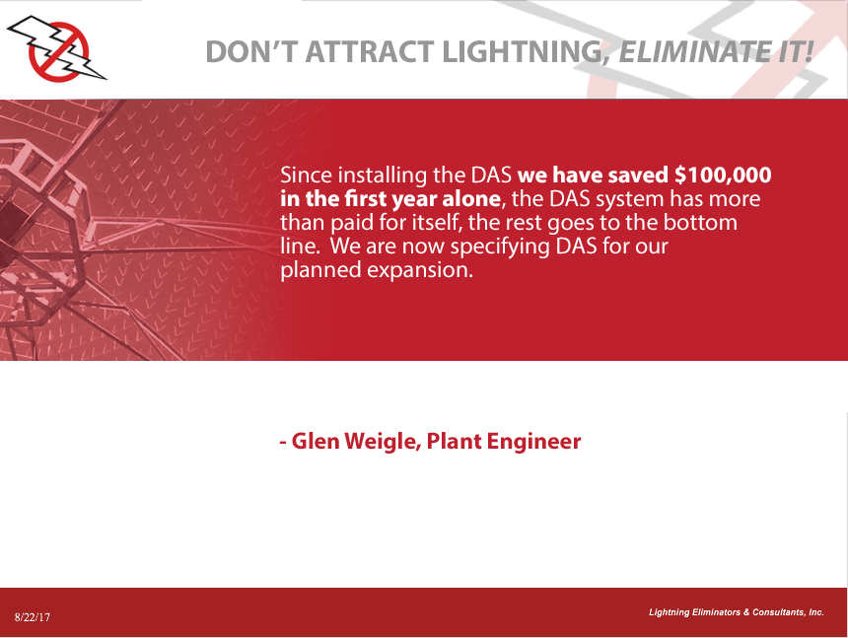
Auburndale Power Partners
Auburndale Power Partners LP

Slide 10
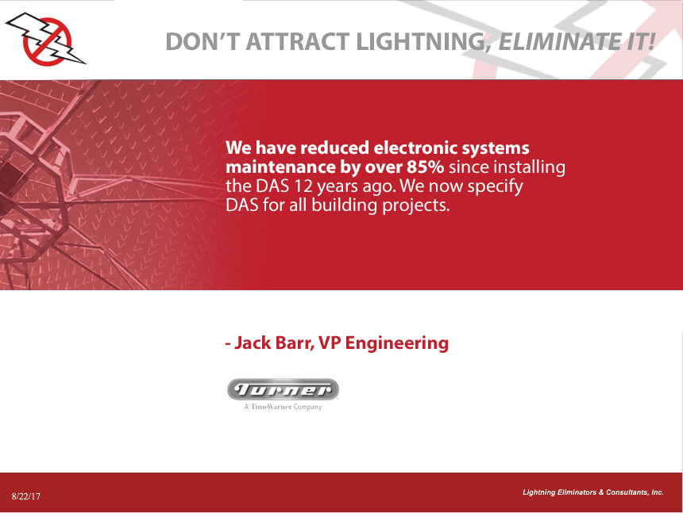

Slide 11
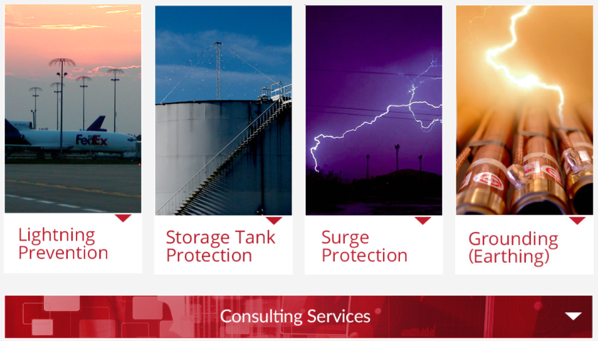
What we do

Slide 12
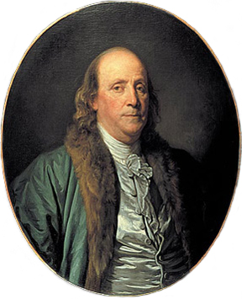
History of Lightning Protection
Ben Franklin
Terminal point for lightning strike
“Design” evolved and based on experience
Developed to protect brick and mortar structures from fire and structural damagedissipate overhead charge in clouds

Slide 13
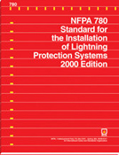
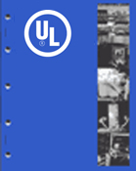
Industry Standards
Over 250 years with no significant changes
Based on “historical precedent”
Intended to collect strikes!

Slide 14
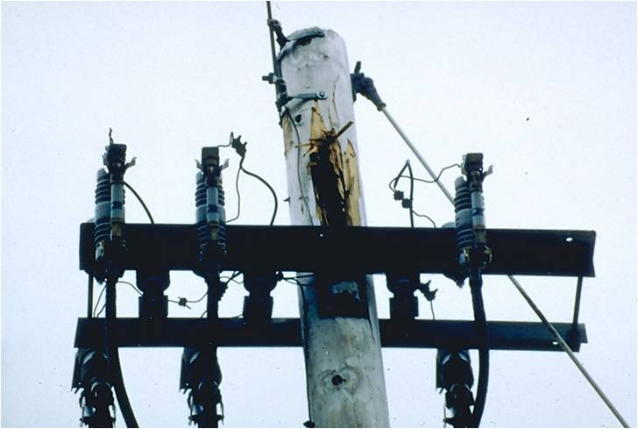
Strike Damage

Slide 15
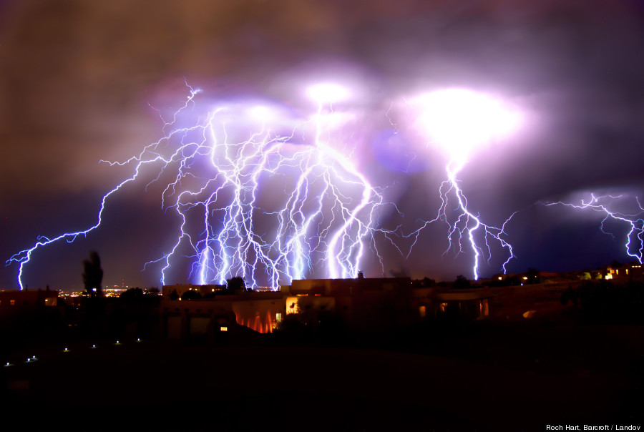
The Lightning Discharge

Slide 16
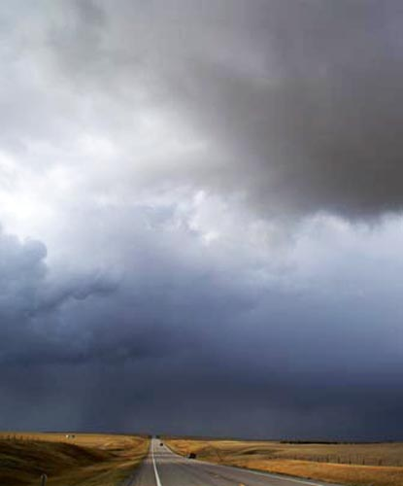
What Creates Lightning?
Water Drops Inside the Cloud
Wind
Frozen Water Drops
Hail
Gravity
Collision
Electron Collection
Charge Separation

Slide 17
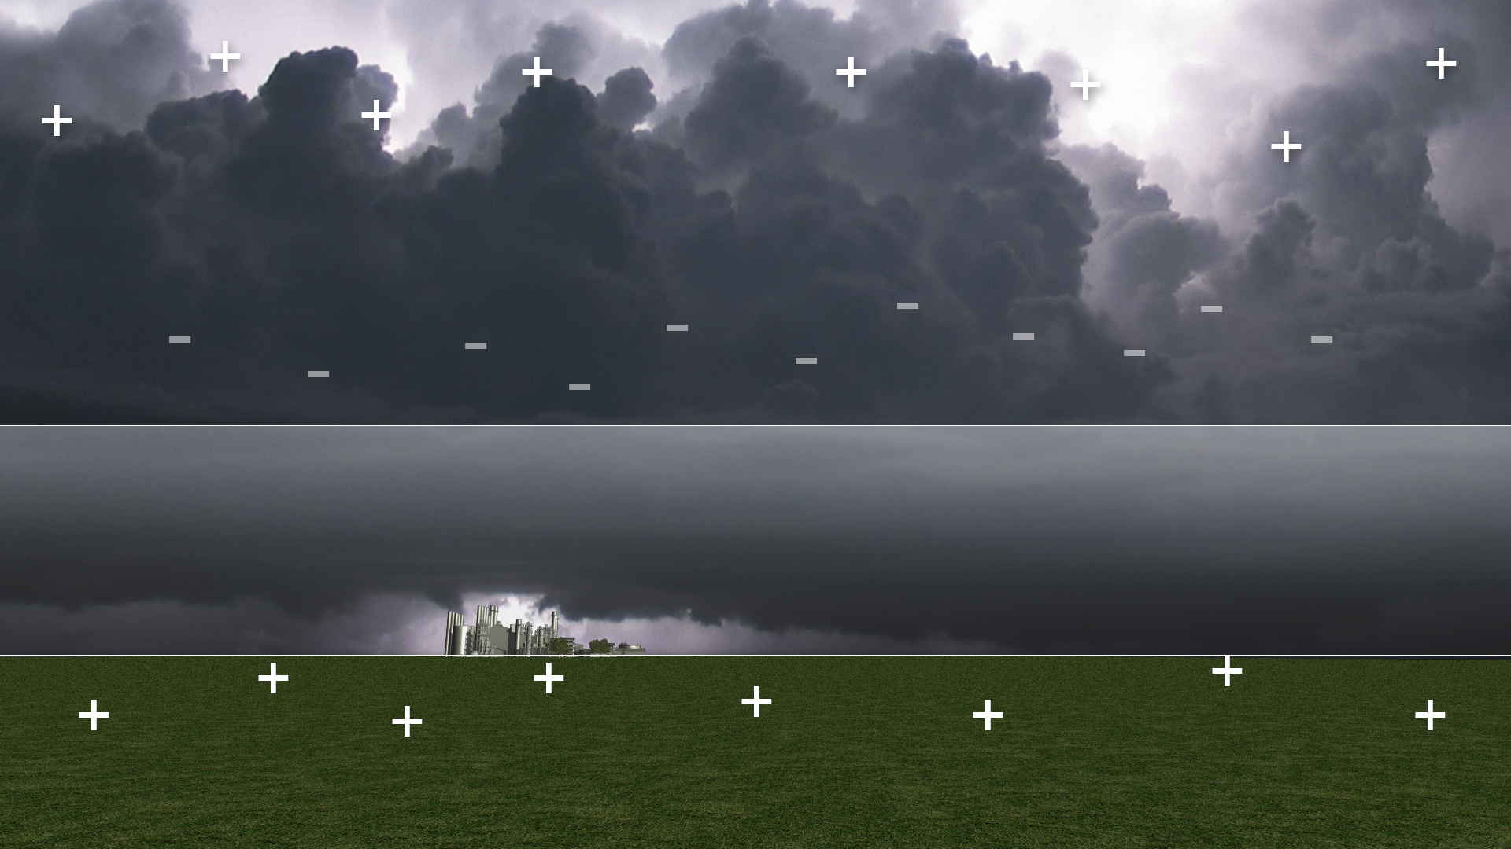
Electrostatic Field
Electrostatic Field
5 to 30 kV/m
Electrostatic Shadow
Copyright ©2013, Lightning Eliminators & Consultants, Inc.

Slide 18
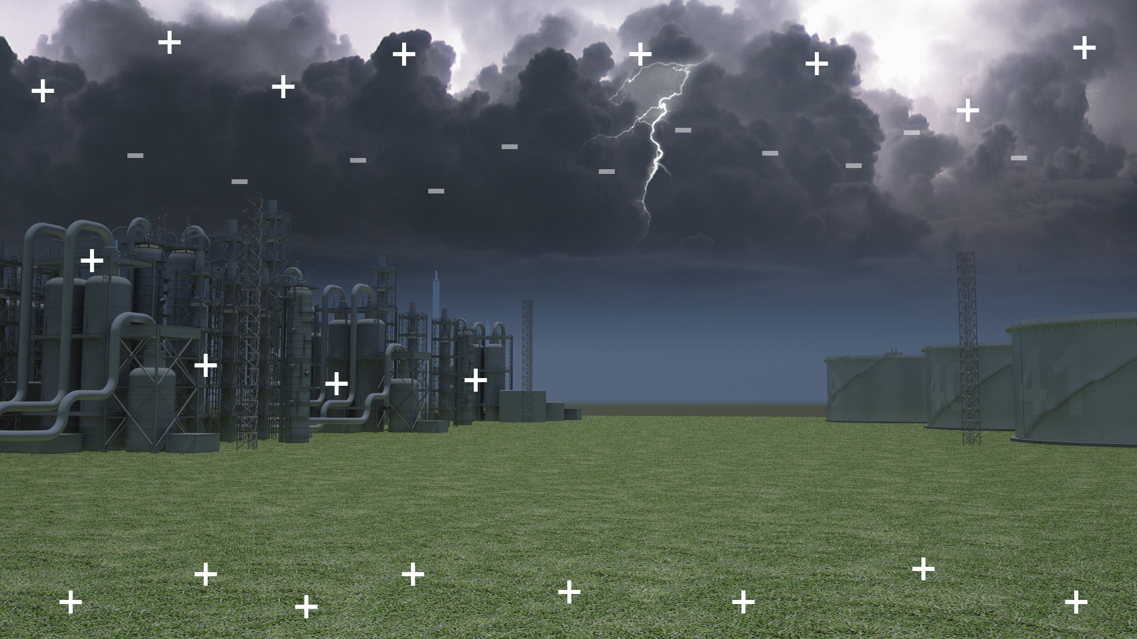
10⁸ V ± 10%
10⁸ V ± 10%
Copyright ©2013, Lightning Eliminators & Consultants, Inc.

Slide 19
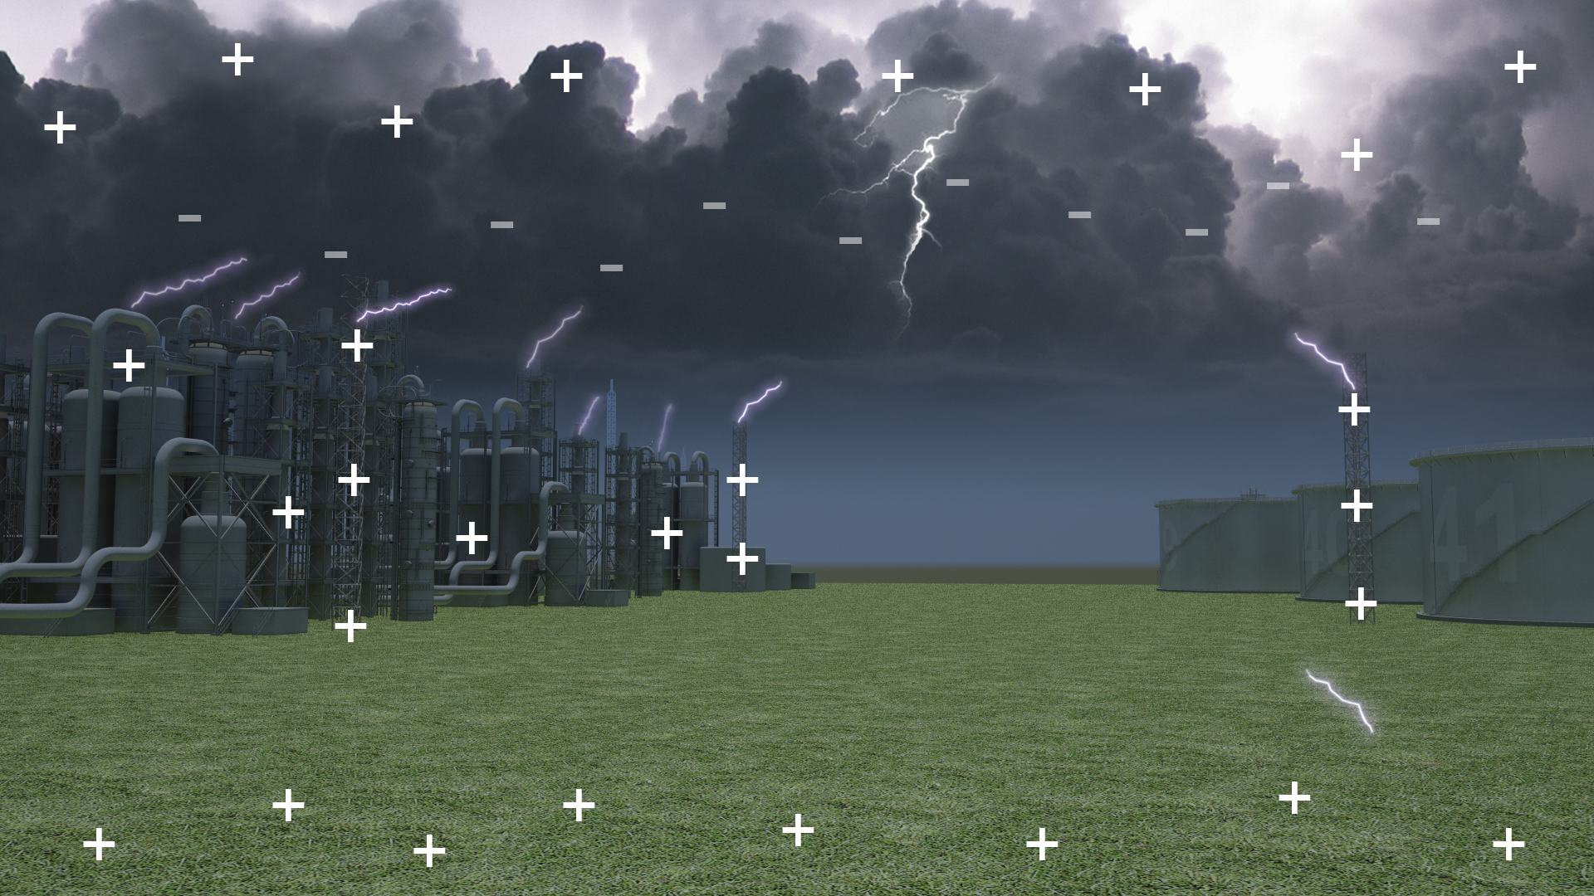
Rising Streamers
RISING
STREAMERS
HIGH-DENSITY CHARGE
Copyright ©2013, Lightning Eliminators & Consultants, Inc.

Slide 20
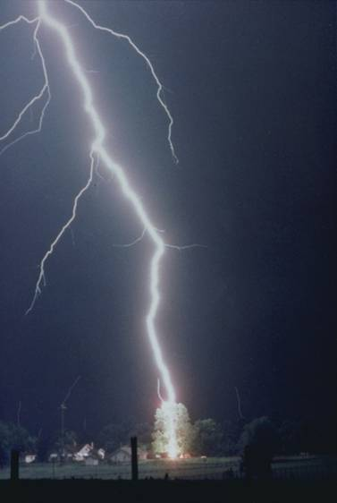
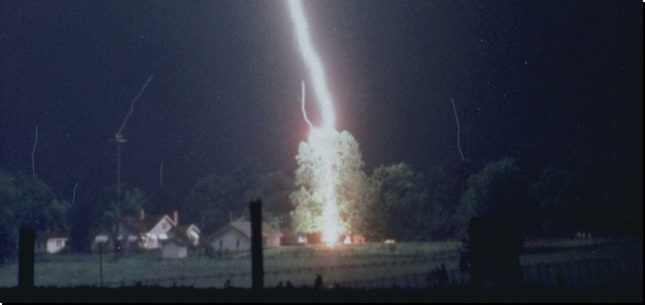
Storm Generated Upward Streamers
Streamers

Slide 21
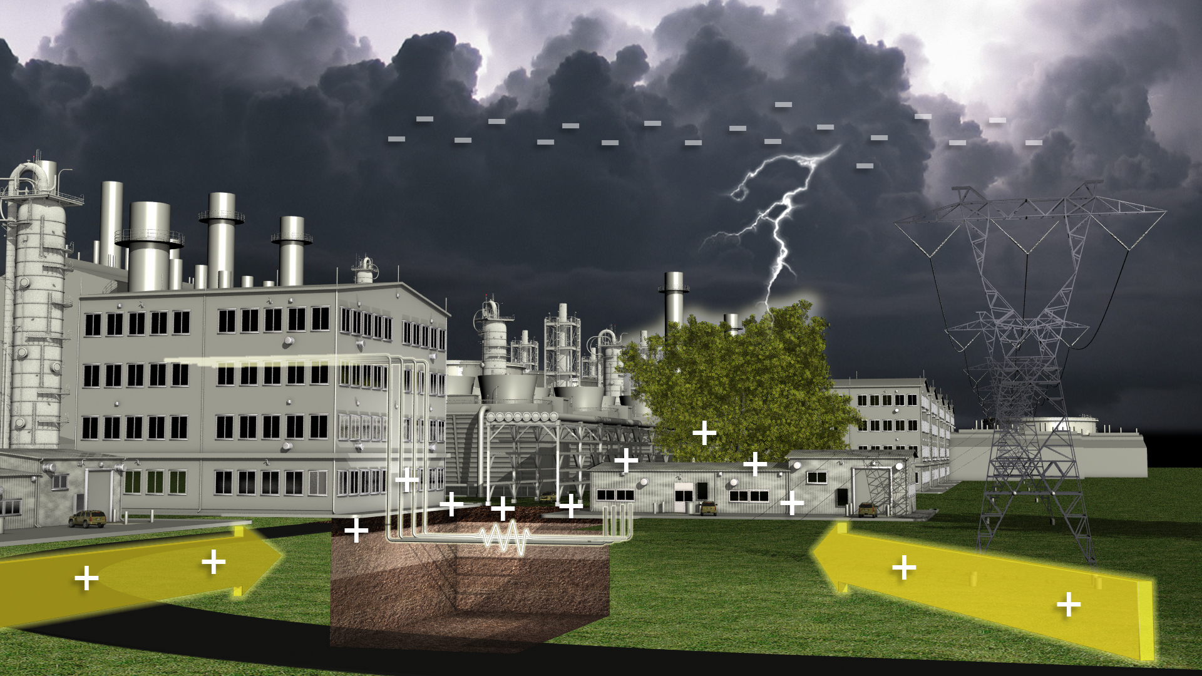
Earth Current Transients
Nearby Strike
Buried Data &
Phone Lines

Slide 22
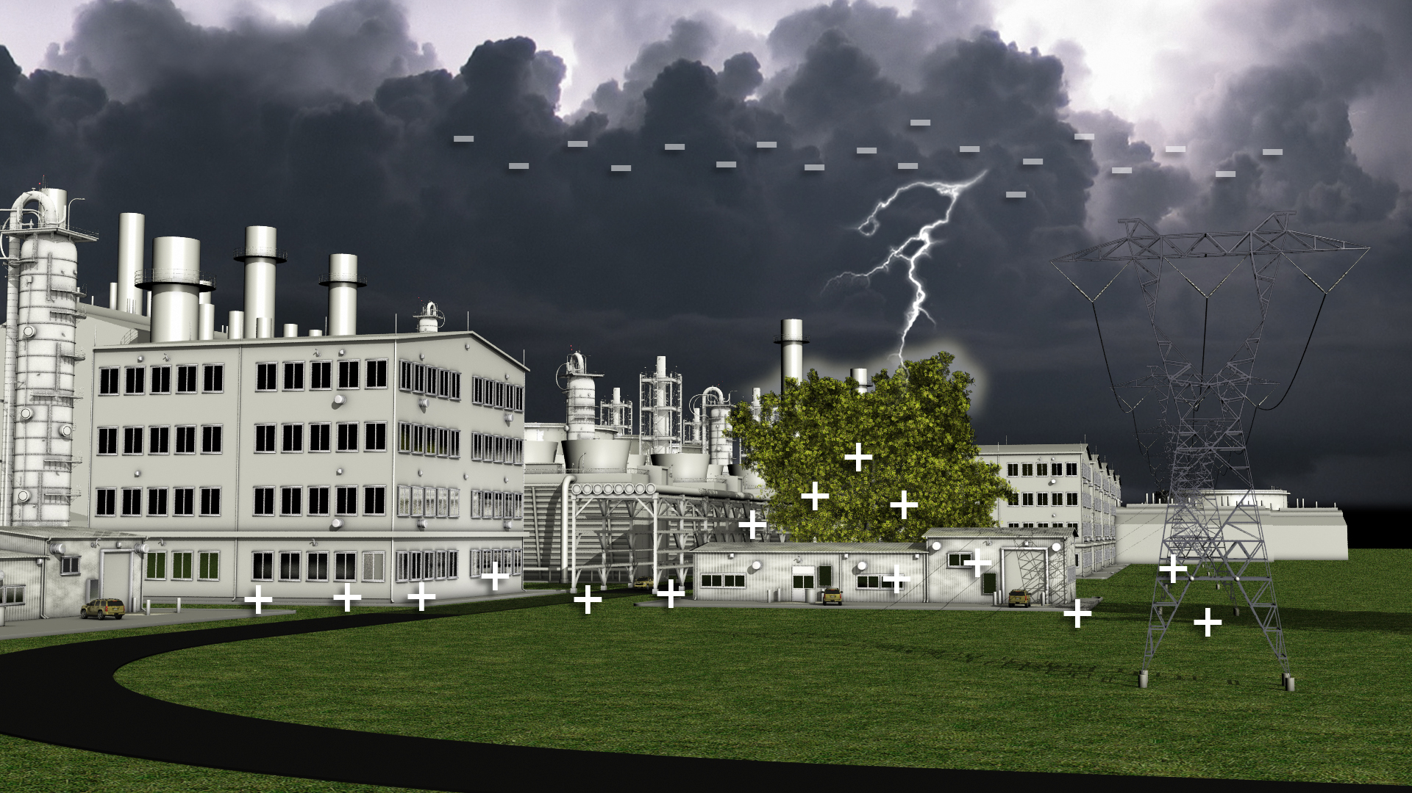
Atmospheric Transients
Field Strength:
5 to 30 kV/m
Nearby Strike

Slide 23
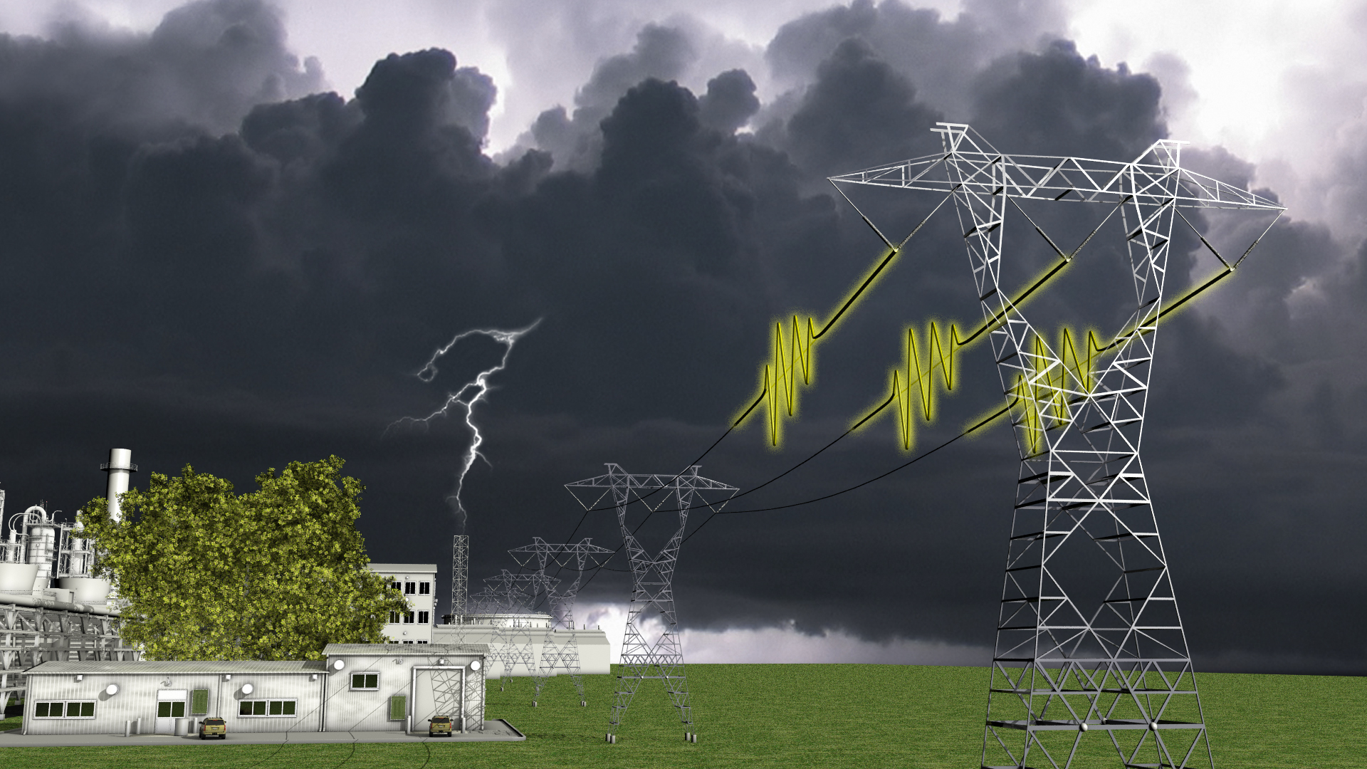
Atmospheric Transients
Overhead Power & Communication Lines

Slide 24
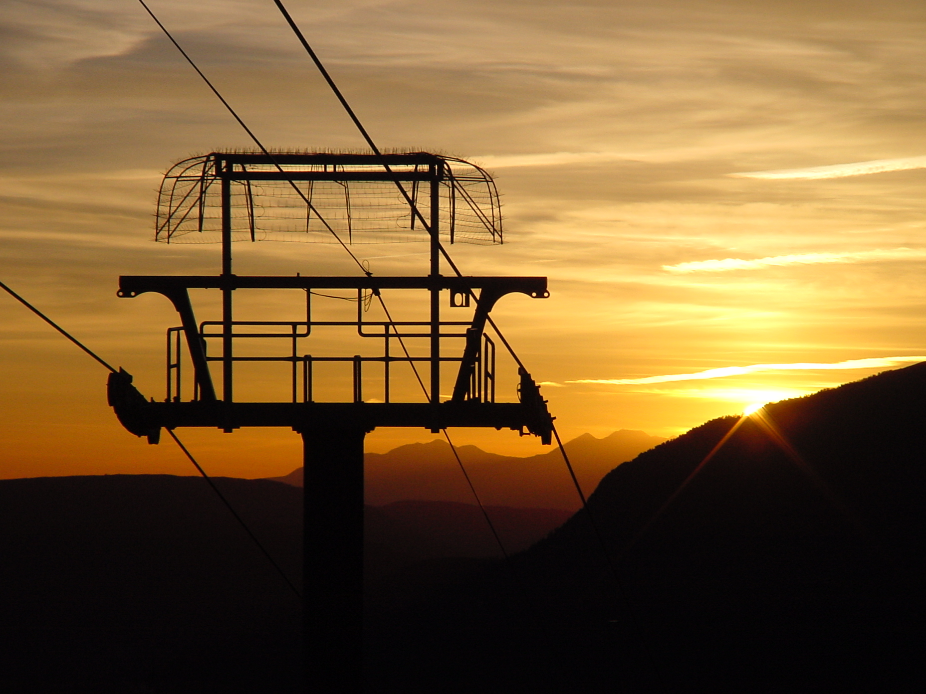
the Dissipation Array™System (DAS™)

Slide 25
DAS™: Proven Performance
In use since 1971
> 99.87% success rate
Over 70,000 system years
Exclusive No-Strike warranty

Slide 26
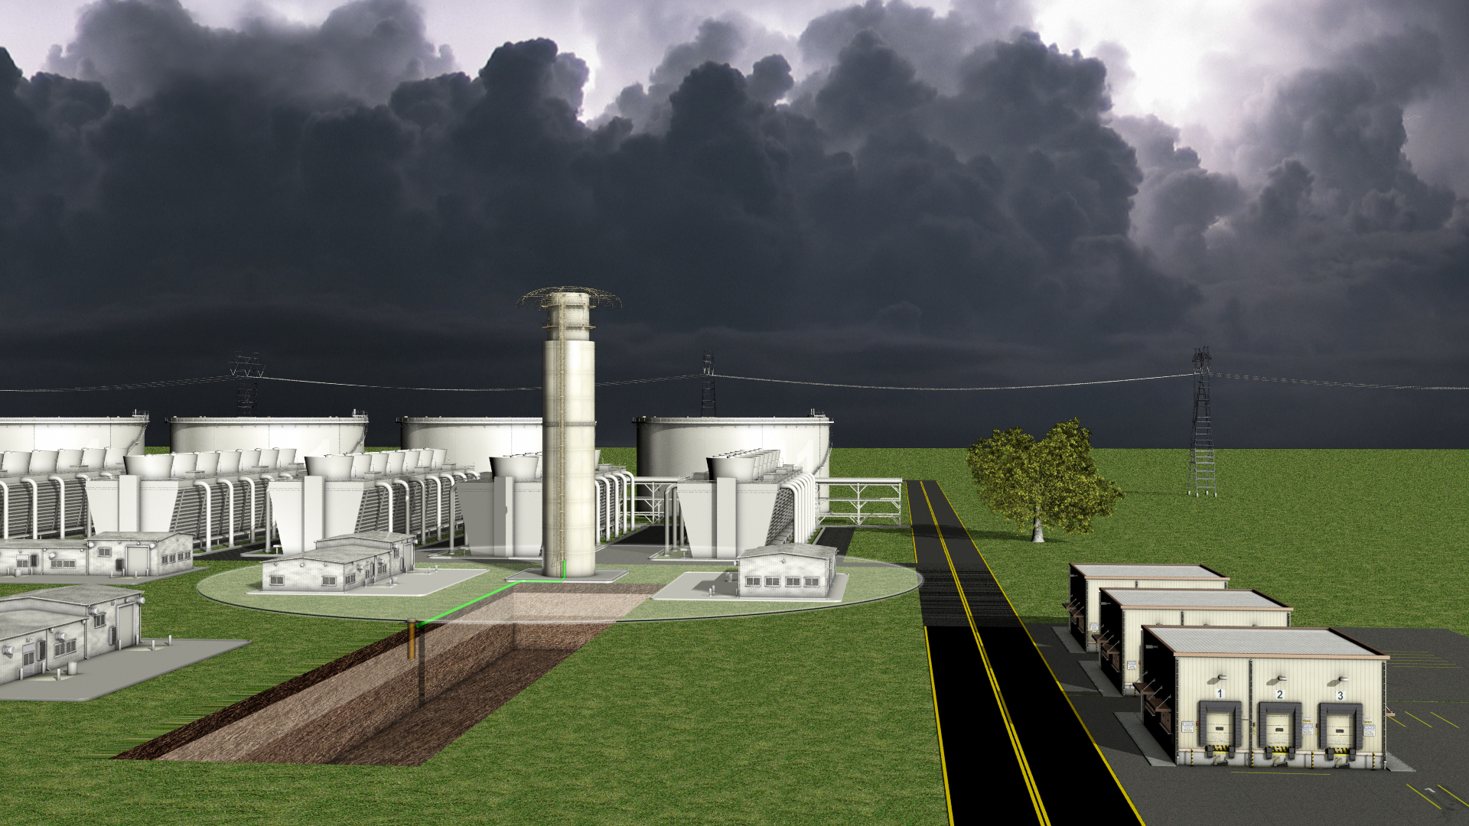
Isolating the Site
Ionizer
Grounding System
Protected Area

Slide 27
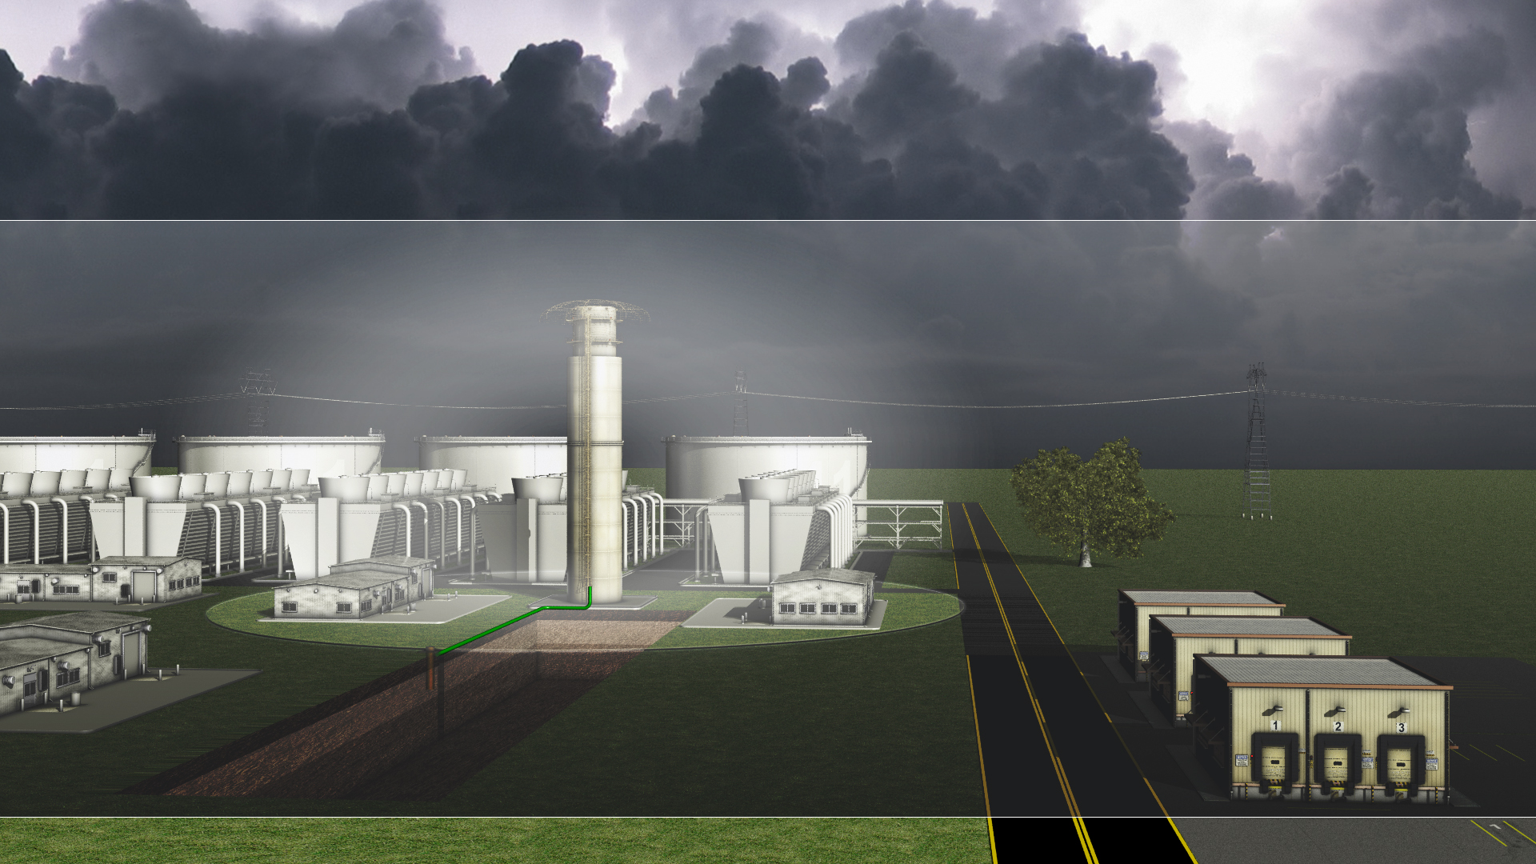
Isolating the Site

Slide 28
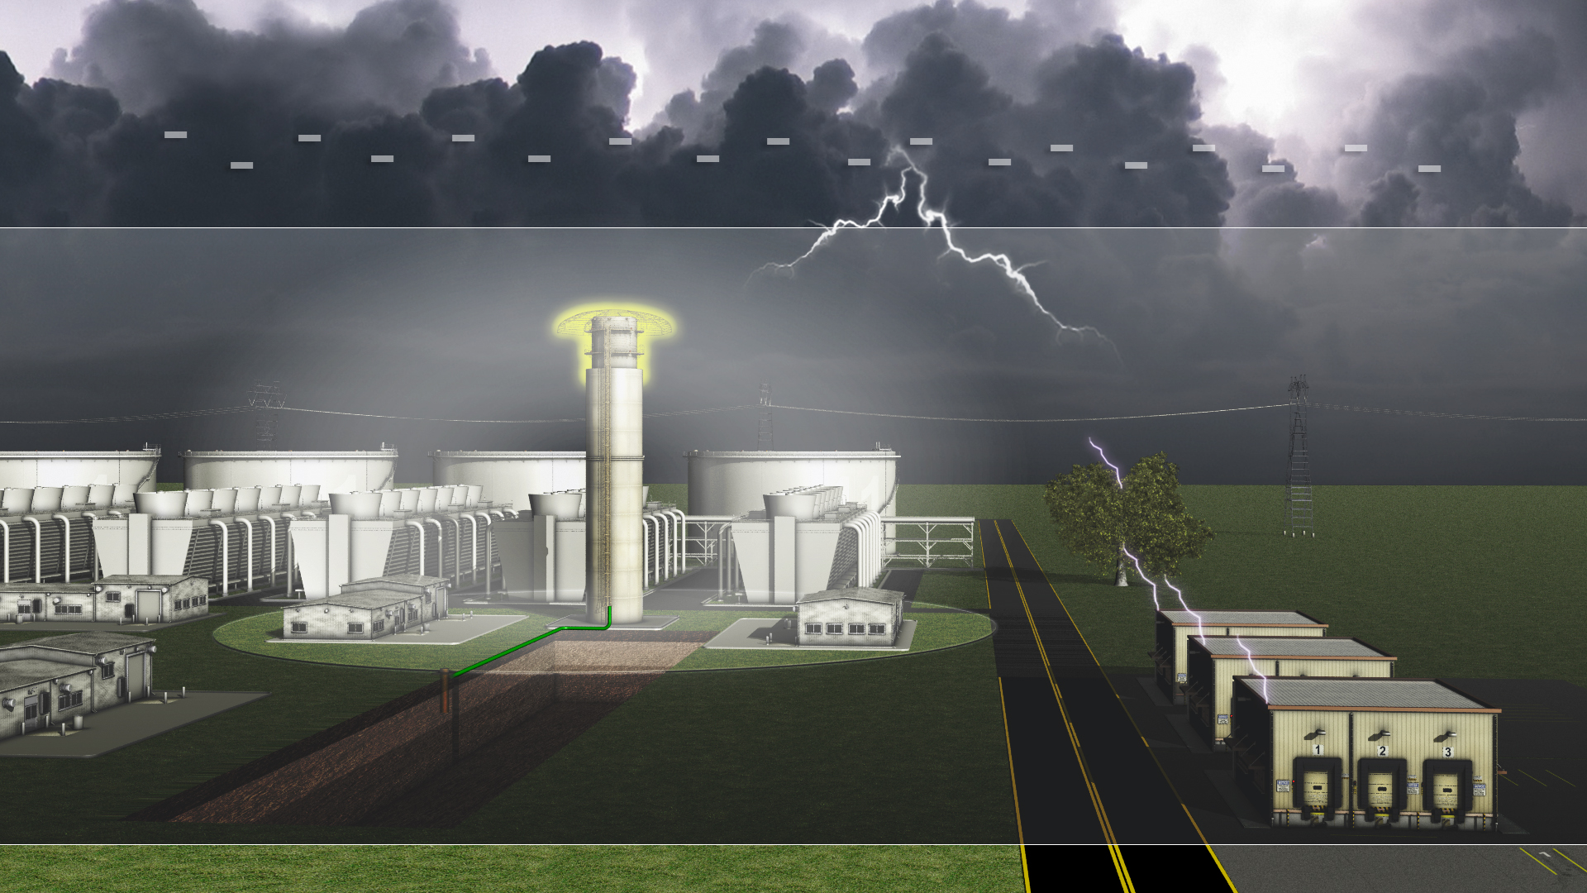
Leader Approaches Space Charge
Leader Approaches Space Charge
Upward Streamers Form
Space Charge Intensifies

Slide 29

Winning the Collection
Winning the Collection

Slide 30
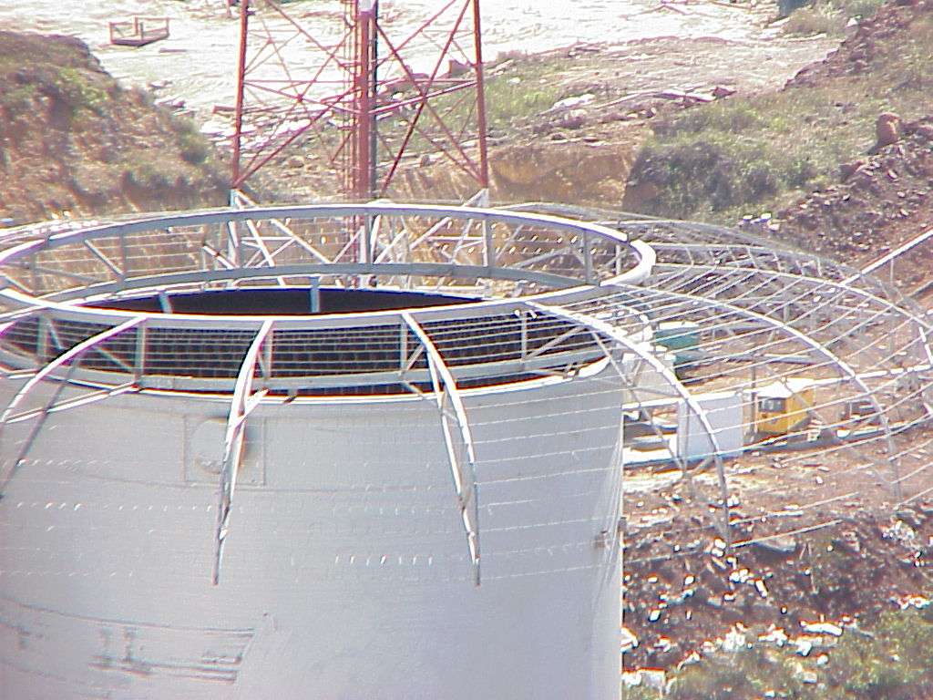
Paper Processing

Slide 31
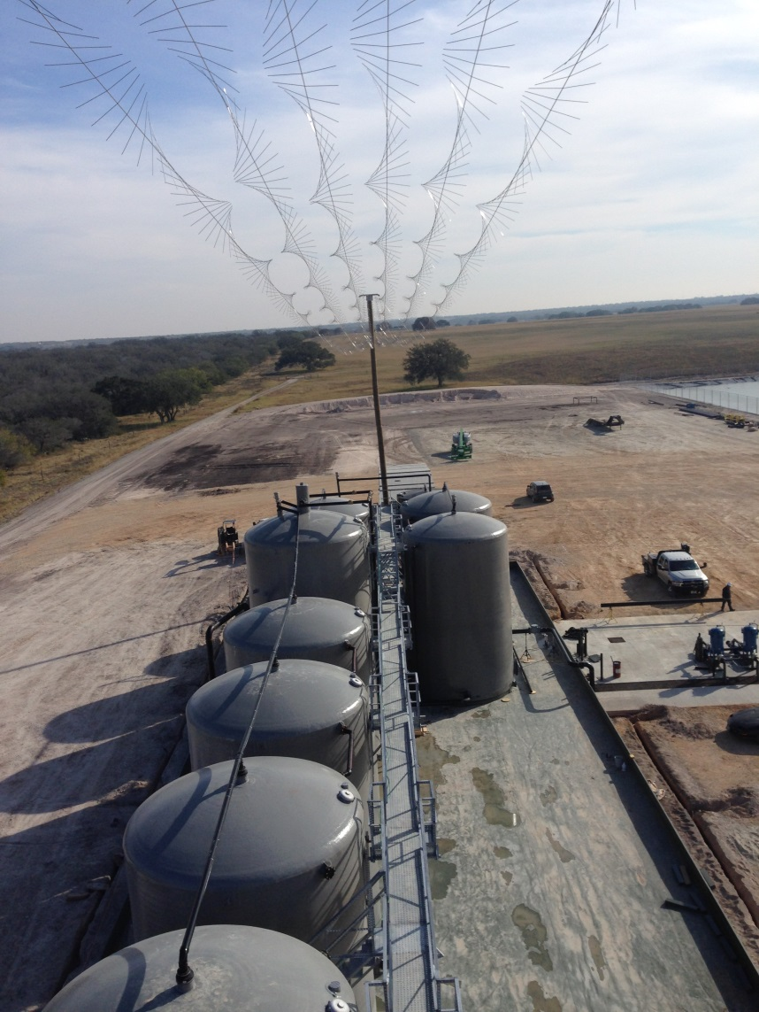
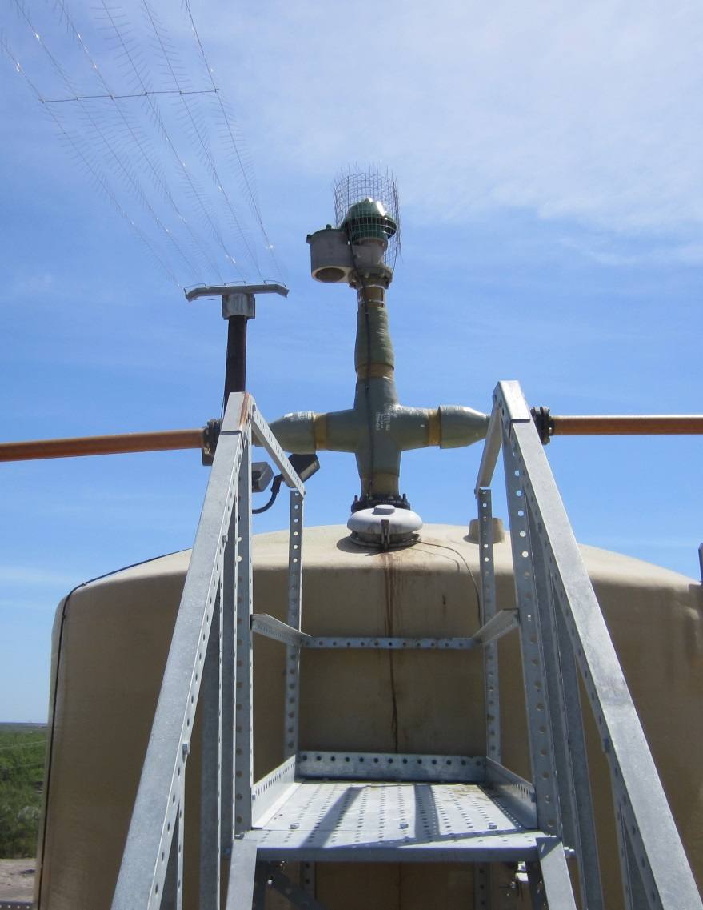
Tank Battery
Tank Battery with Paragon Array

Slide 32
Process Facility
PPG Chemical
USA

Slide 33
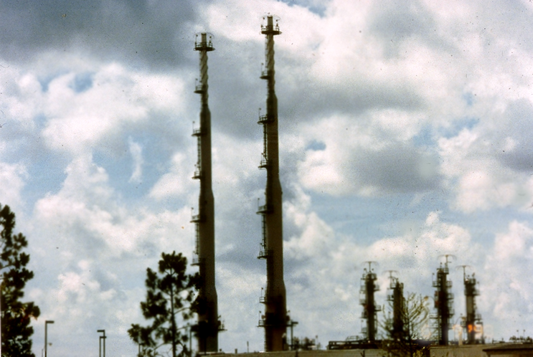
Gas Processing Facility
Exxon-Mobil,
Mobile Bay, Alabama

Slide 34
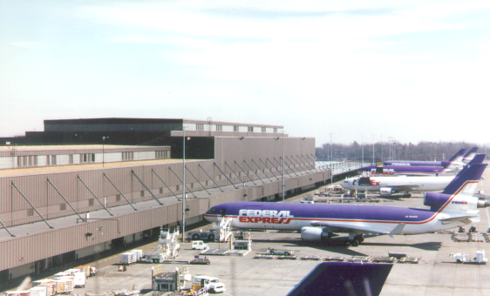
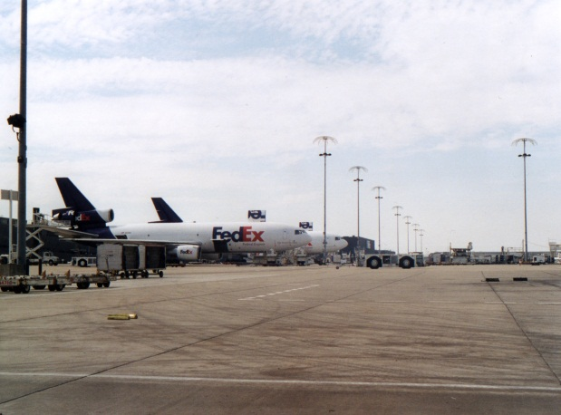
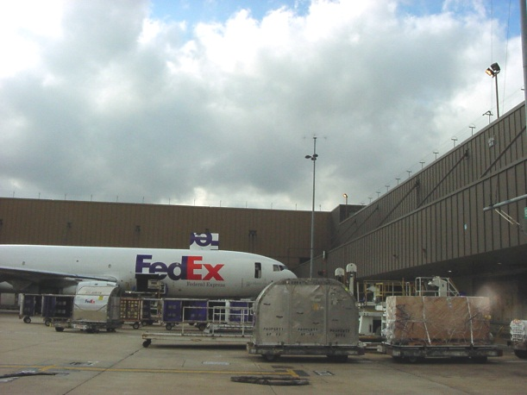
FEDEX Super Hub Memphis, TN, USA
Total Facility = 3 Sq. Km with over 1 billion Sq. Ft. of buildings and space protected

Slide 35
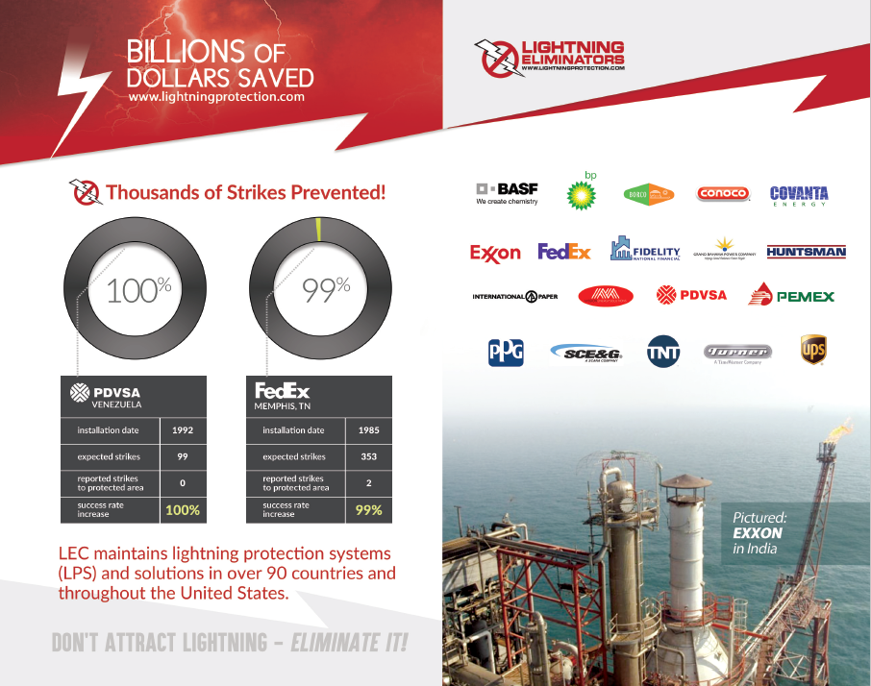

Slide 36
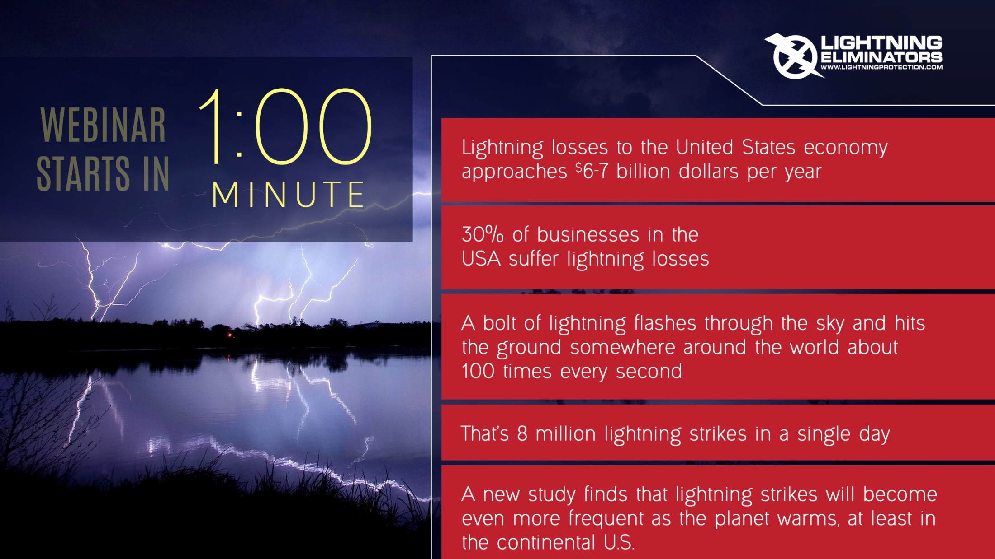
In Conclusion
Fully detailed technical version of this presentation available on YouTube!
Lightning Eliminators Channel
Questions???
Shawn Moya
smoya@lecglobal.com
303-951-3155

